Slide 1
_{Website blockEr and UnBlocker}
AS A STANDALONE APPLICATION
TEAM MEMBERS NAME
1.JUSTUS KEVIN. T
2. RAMANAN. K
3. PRAVEEN. G

Slide 2
Objective of project
THE OBJECTIVE OF WEBSITE BLOCKER AND UNBLOCKER PROJECT IS TO BLOCK/UNBLOCK THE GIVEN WEBSITES FROM PC’s/LAPTOPS (WINDOWS/LINUX/MAC OS) VIA LOCAL ADMOINISTRATOR .
2. THIS PROJECT WILL HELP LOCAL ADMINISTRATOR WHO SHARE THEIR DEVICE WITH LOCAL USERS TO STAY AWAY FROM SO THAT THEY CAN NOT OPEN THEM. ONLY THE LOCAL ADMINISTRATOR OF THEIR DEVICE CAN UNBLOCK AND BLOCKED WEBSITE IF REQUIRED

Slide 3
ABSTRACT
WEBSITE BLOCKER/UNBLOCKER IS AN APPLICATION TOOL THAT DENIES AND PERMITS ACCESS TO WEBSITES PERMANENTLY OR BY SCHEDULE TO USE THE INTERNET SAFELY THE LOCAL ADMINISTRATOR CAN BLOCK ALL WEBSITES FROM UNWANTED CATEGORY LIST AND IF REQUIRED THE LOCAL ADMINISTRATOR CAN ALSO UNBLOCK THOSE WEBSITES FROM THE SAME LIST

Slide 4
INTRODUCTION TO DOMAIN
UTLITY SOFTWARE:
UTILITY SOFTWARE HELPS MANAGE, MAINTAIN AND CONTROL A COMPUTER MAINTAIN AND CONTROL A COMPUTER AND SUPPORT IT’S INFRASTRUCTURE. EVERY FUNCTIONALITY OF THE COMPUTER USES A UTILITY SOFTWARE. UTILITY SOFTWARE IS SET OF TOOLS THAT HELPS CONFIGURE, ANALYSE AND OPTIMIZE COMPUTER RESOURCES TO HELP USERS PERFORM MULTIPLE TASKS EFFICIENTLY. MOST OF THE OPERATING SYSTEMS HAVE INPUT BUILD-IN UTILITY TOOLS, BUT ADDITIONAL SOFTWARE FURTHER ENSURE IMPROVED FUNCTIONALITY. UTILITY SOFTWARE FOCUSES ON COMPUTER COMPONENTS SUCH A HARDWARE, SOFTWARE OPERATING SYSTEM, NETWORK CONFIGURATION AND STORAGE PARTS.
EXAMPLE:DATA GENERATORS, HEXEDITORS, HTML CHECKERS AND MERGE PROGRAMS

Slide 5
ALGORITHM
ALGORITHM FOR WEBSITE BLOCKER APPLICATION:
LOCAL ADMINISTRATOR ENTERS MULTIPLE WEBSITES TO BLOCK
THEN CLICKING ON THE BLOCK BUTTON WILL CHECK THE CONDITION THAT IF THE WEBSITE IS ALREADY BLOCKED
IF ALREADY BLOCKED THEN IT DISPLAYS ‘ALREADY BLOCKED’
ELSE IF BLOCKS ALL THE MENTIONED WEBSITES AND DISPLAYS ‘BLOCKED’
ALGORITHM FOR WEBSITE UNBLOCKER APPLICATION:
LOCAL Administrator enters one website at a time TO UNBLOCK
THEN CLICKING ON THE UNBLOCK BUTTON WILL CHECK THE CONDITION THAT IF THE WEBSITE IS ALREADY UNBLOCkED
IF ALREADY UNBLOCKED THEN IT DISPLAYS ‘ALREADY UNBLOCKED’
ELSE IF UNBLOCKS THE MENTIONED WEBSITE AND DISPLAYS ‘UNBLOCKED’

Slide 6
EXISTING SYSTEM
THE LOCAL ADMINISTRATOR NEEDS TO MANUALLY ENTER TO REMOVE THE WEBSITE NAME THE LOCALHOST IP ADDRESS IN THE HOST FILE. ALSO THE LOCAL ADMINISTRATOR CAN WRITE A SCRIPT FOR BLOCKING THE WEBSITES BUT REQUIRES TO MODIFY THE SCRIPT IF NEW WEBSITES ARE NEEDED TO BLOCK. THE PROCESS TO CHANGE THE SCRIPT WILL BE TEDIOUS IF THE SCRIPT IS AUTOMATED WITH OS TASKS

Slide 7
DISADVANTAGES
REQUIRES MANUAL OPERATION TO ADD OR REMOVE WEBSITE IN HOST FILE
THE SCRIPT NEEDS TO BE MODIFIED WHEN NEW WEBSITES ARE ADDED
REQUIRES MORE EFFORT IF THE SCRIPT IS AUTOMATED WITH THE OS TASKS
ONCE THE SCRIPT IS AUTOMATED WEBSITES CANNOT BE UNLOCKED /BLOCKED AT ANY TIME AS PER LOCAL ADMINISTRATOR THOUGHT

Slide 8
PROPOSED SYSTEM
IN THIS WEBSITE BLOCKER /UNBLOCKER PROJECT THE LOCAL ADMINISTRATOR JUST NEEDS TO ENTER THE WEBSITE NAME TO BLOCK/UNBLOCK USING GUI(GRAPHICAL USER INTERFACE) AT ANY TIME PROVIDED BY THE APPLICATION PERMANENTLY

Slide 9
Advantages
SIMPLE TO USE
SCHEDULED BLOCKING IS NOT REQUIRED
APPLICATION EFFECT WILL BE PERMANENT
WEBSITES CAN BE BLOCKED/UNBLOCKED AT ANY TIME AS PER LOCAL ADMINISTRATOR THOUGHTS

Slide 10
Reference survey
AN OVERVIEW OF INTERNET CONTENT BLOCKING /ISOC INTERNET SOCIETY, 24 MARCH 2017
INTERNET CONTENT FILTERING GUIDELINE-DEPARTMENT OF EDUCATION AND TRAINING(TITLE:GUIDELINES FOR MANAGING ACCESS TO CONTENT ON THE INTERNET) , 22 OCTOBER 2018
THE EFFECTIVENESS OF INTERNET CONTENT FILTERS, JANUARY 2008
RFC 7754-TECHNICAL CONSIDERATIONS FOR INTERNET SERVICE BLOCKING AND FILTERING, MARCH 2016
COMPARTIBLE STUDY ON BLOCKING, FILTERING AND TAKE-DOWN OF ILLEGAL INTERNET CONTENT, 20 DECEMBER 2015

Slide 11
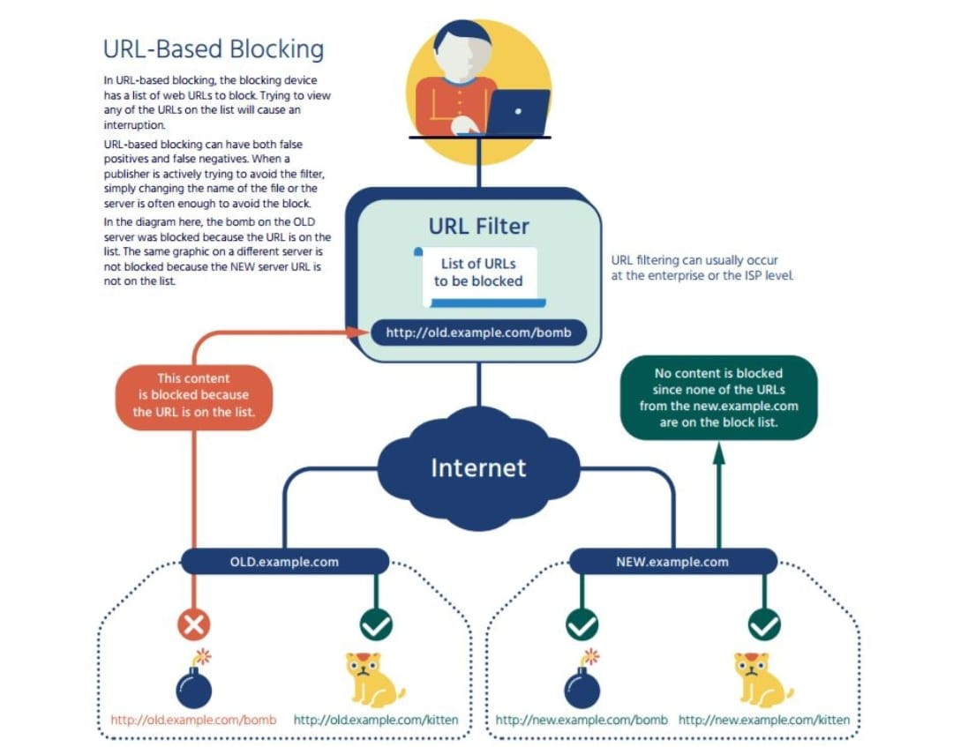
ARCHITECTURE DIAGRAM OF PROJECT

Slide 12
IMPLEMENTATION METHOD
EVERY SYSTEM HAS HOST FILE WHETHER IT IS MAC, WINDOWS OR LINUX.
HOST FILE IN MAC AND LINUX :
/ETC/HOSTS
HOST FILE IN WINDOWS:
C:\WINDOWS \SYSTEM32\DRIVERS\ETC\HOSTS.
WORKING OF HOST FILE:HOST IS AN OPERATING SYSTEM FILE WHICH MAPS HOSTNAMES OF WEBSITES TO OUR LOCALHOST ADDRESS . USING PYTHON FILE HANDLING MANIPULATION THE HOSTNAME WILL BE WRITTEN IN OR REMOVED FROM HOSTS. TXT OF THE RESPECTIVE OS

Slide 13
FUTURE ENHANCEMENT
To INCLUDE THE ABILITY TO BLOCK THE MENTIONED WEBSITE FOR A PARTICULAR LOCAL USER
To integrate the same application in IOS, ANDROID
ABILITY TO BLOCK MENTIONED WEBSITES FOR A PARTICULAR PERIOD OF TIME

Slide 14
Thank you

